Slide 1
Increasing World Population and It’s Effects
PRESENTED BY: Abhishek Negi & Aakash
Msc. Computer science(cohort 2025)
Subject : Tools & Methods of data analysis

Slide 2
Introduction
Increase in world population and major regions
Comparison among the regions
Adverse effects of increase in population
1950 vs 2023
Resources

Slide 3
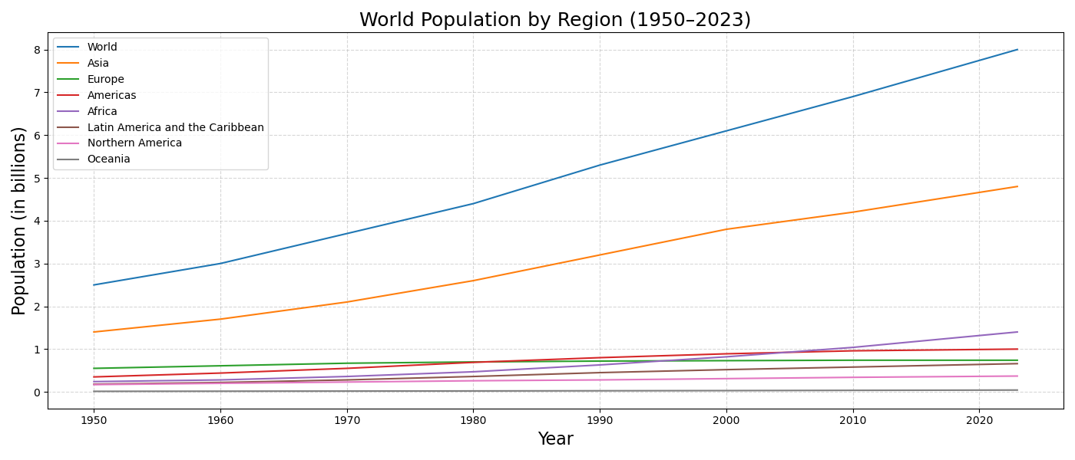
World population vs Major Regions
Fig 1. World population by region

Slide 4
Comparison among Regions
Entity | Year | Population (in 100 millions)
Africa (UN) | 2023 | 1.480770476
Americas (UN) | 2023 | 10.41794207
Asia (UN) | 2023 | 47.78004427
Europe (UN) | 2023 | 7.45602817
Latin America and the Caribbean (UN) | 2023 | 6.58891468
Northern America (UN) | 2023 | 3.8290269
Oceania (UN) | 2023 | 0.45562735
Asia inhabits more than 50% of the world population
Most of the regions have a constantly increasing population
Europe is the only region where the increment seems to be stagnant or in decline
Table 1. Population in major land masses

Slide 5
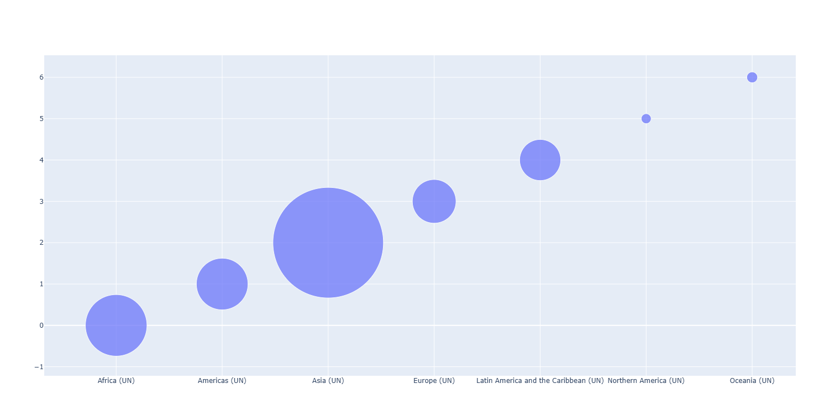
Graphical representation
Fig 2. Comparison among regions

Slide 6
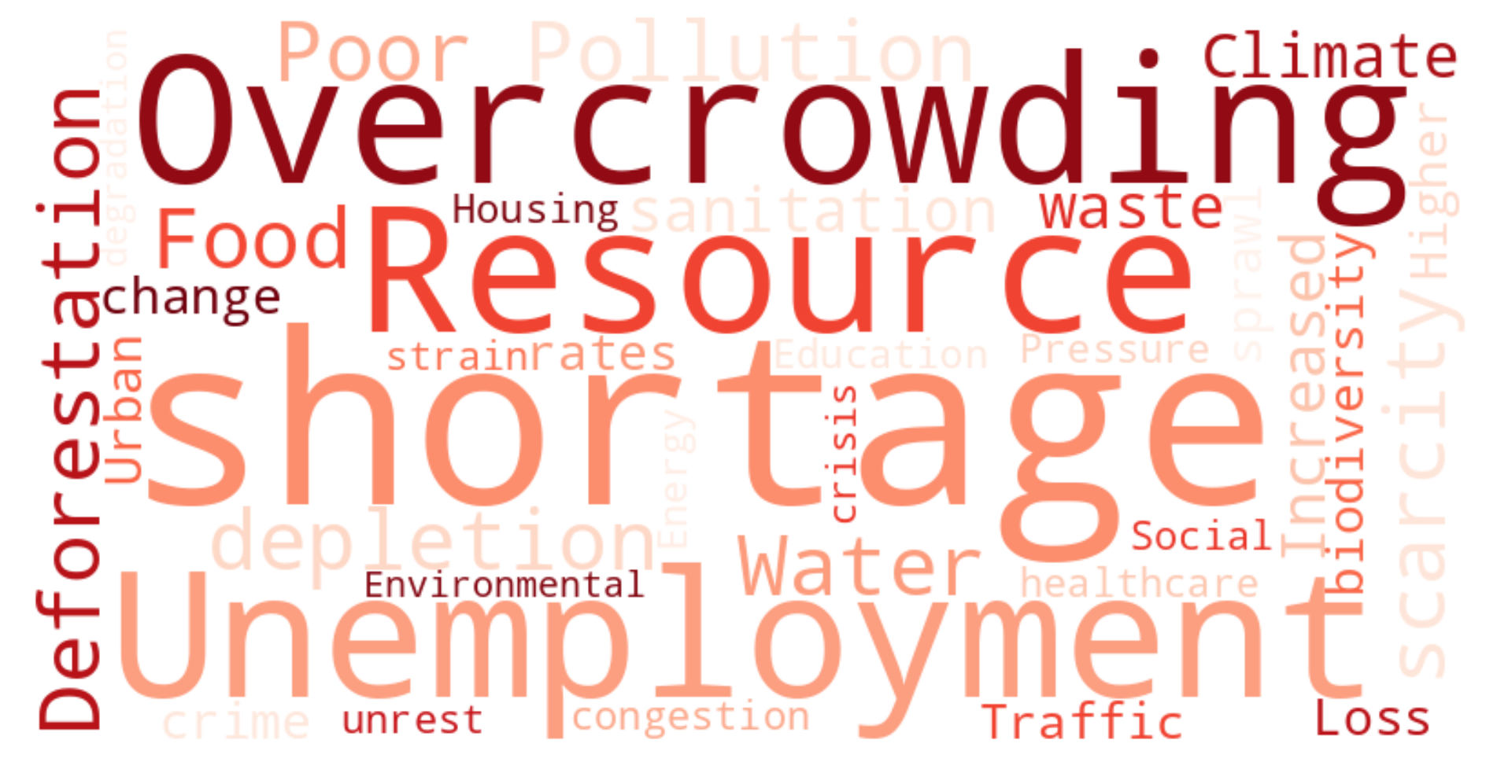
Adverse effects
Fig 3. Word cloud depicting negative effect of population increase

Slide 7
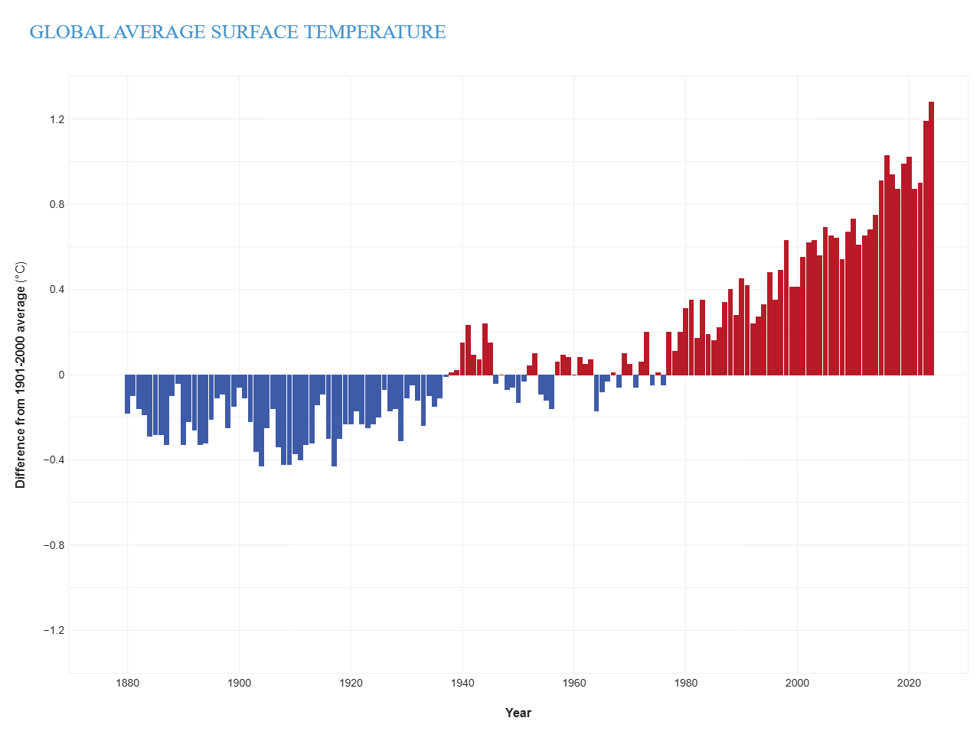
Global Surface temperature
Steep rise in global temperature with population
Global warming
Emission of Carbon Dioxide, methane and burning of fuels
Deforestation
Fig 4. Global surface temperature

Slide 8
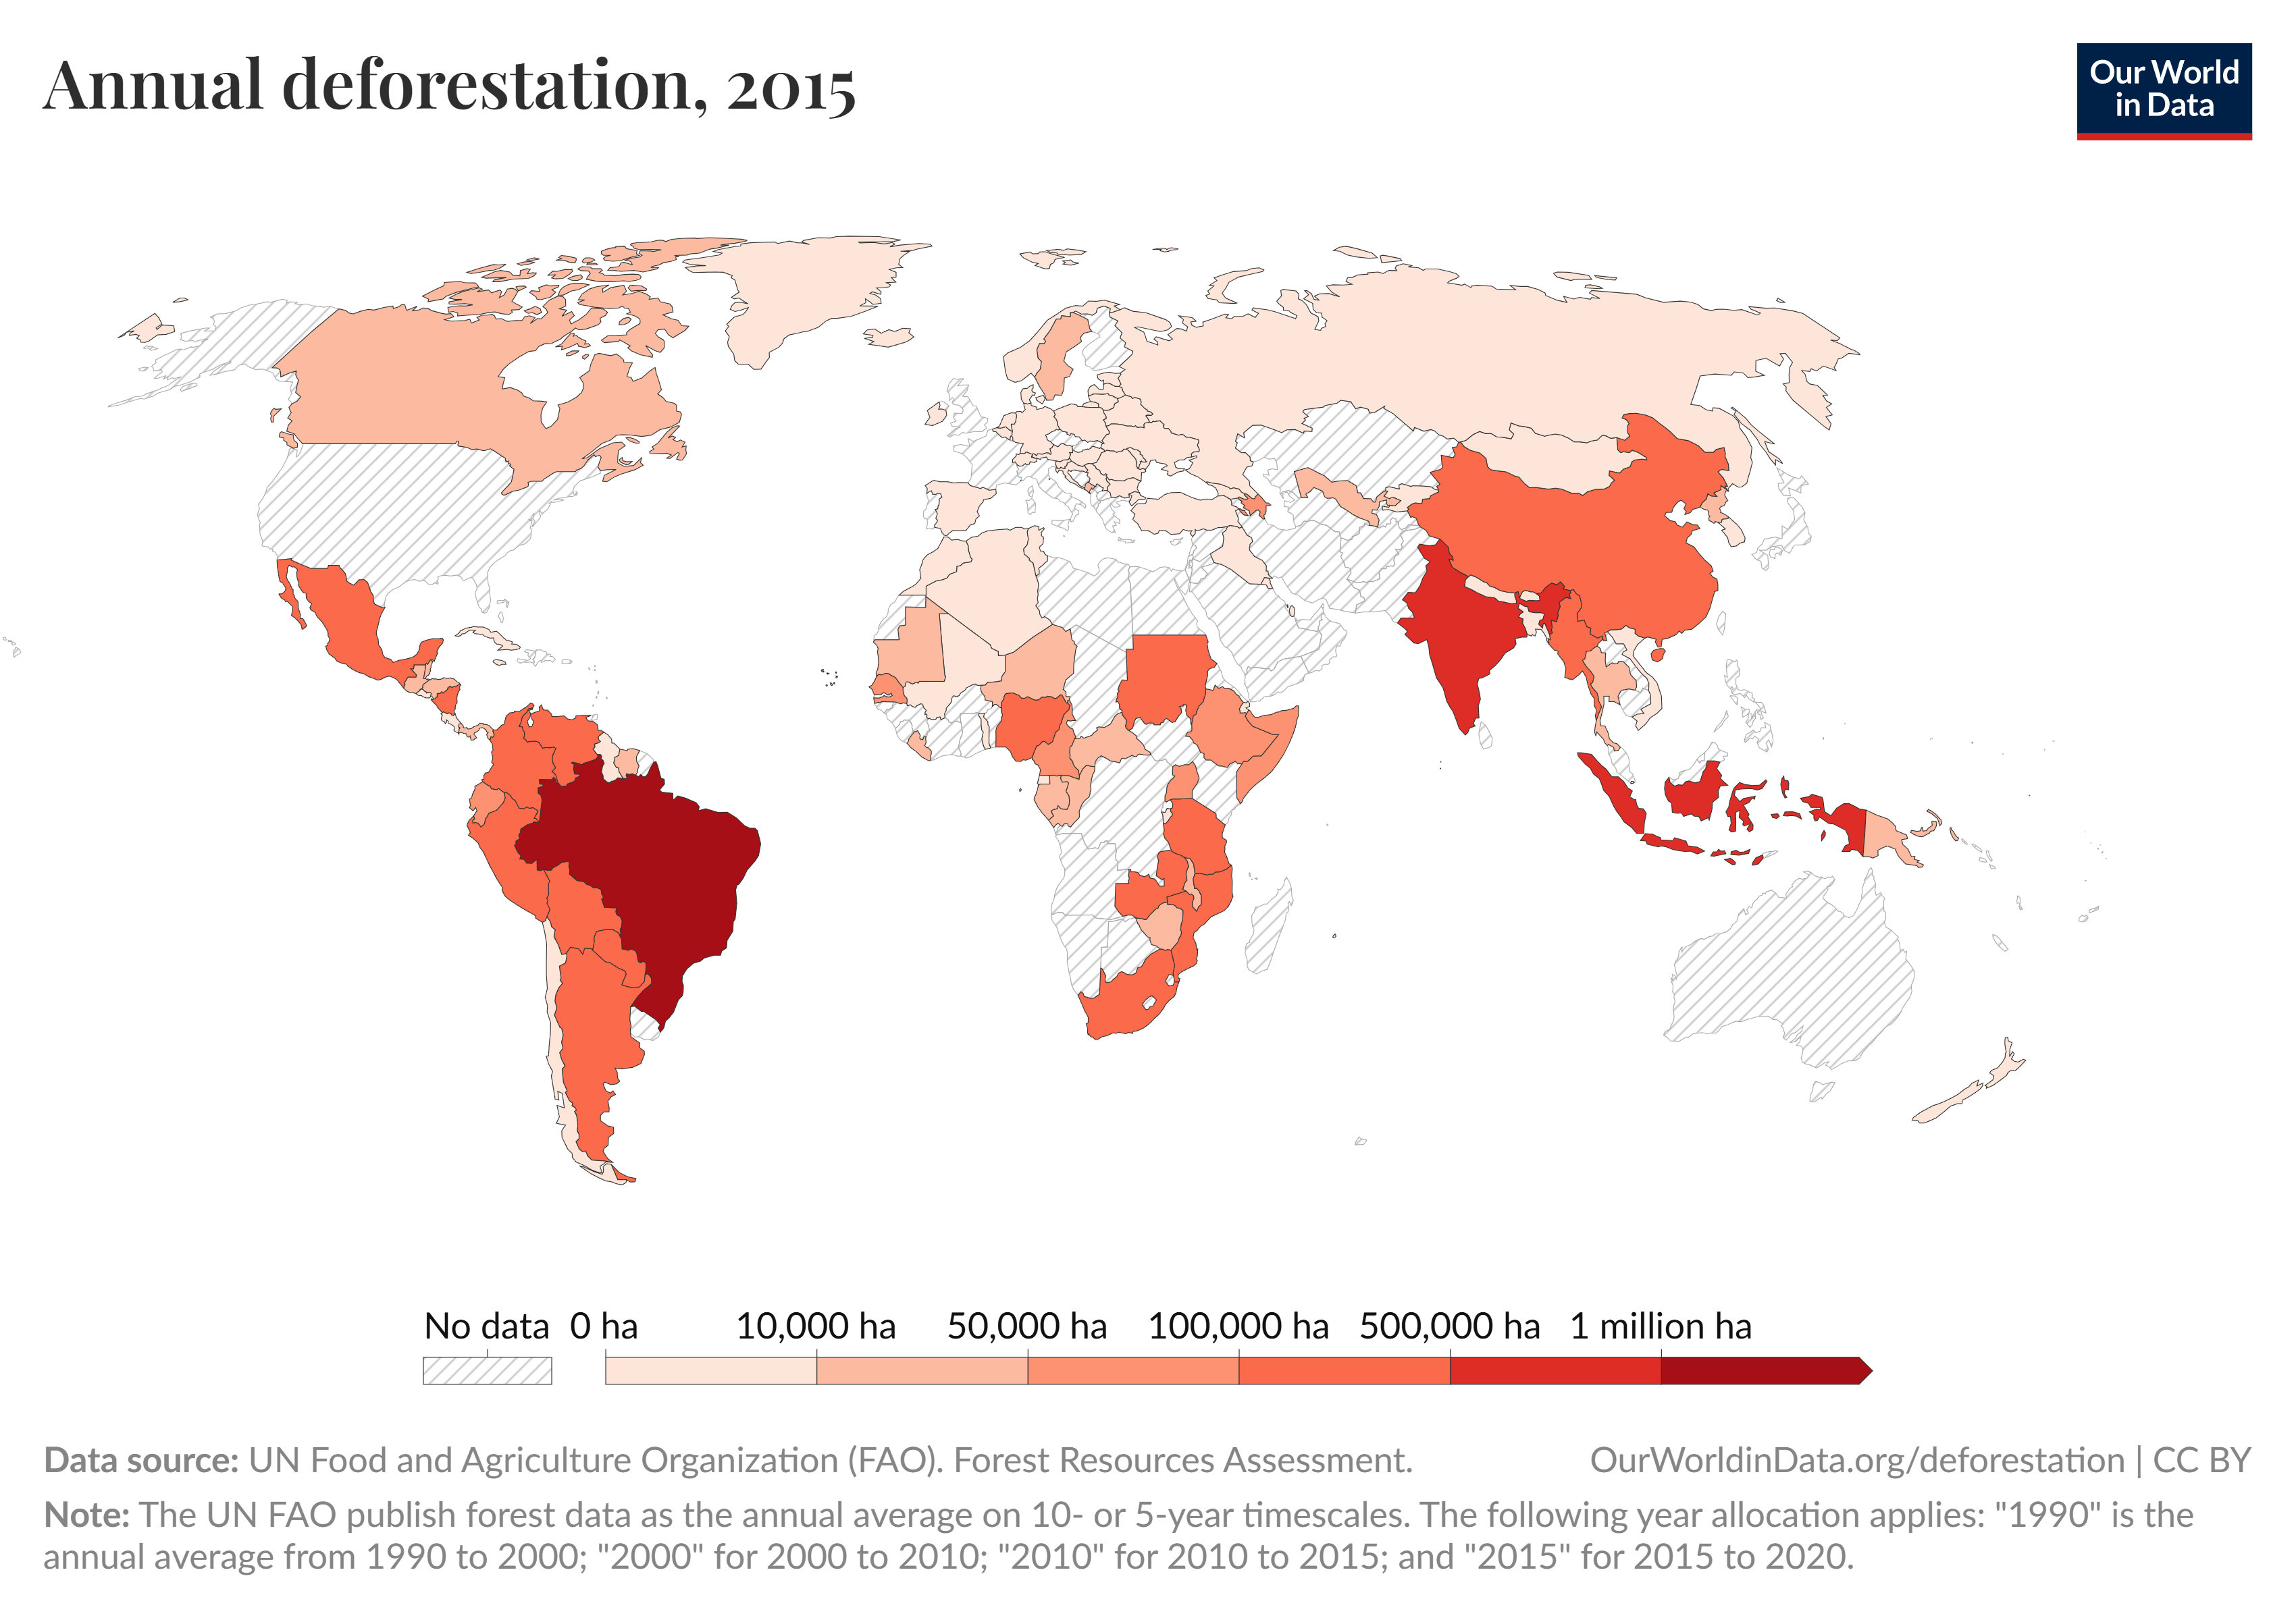
Deforestation
Net loss of ~129 million hectares since 1990 — an area roughly the size of South Africa
Average annual net forest loss: around 3.3 million hectares per year
South America and Africa saw the largest net losses
Fig 5. World map for annual deforestation rate

Slide 9
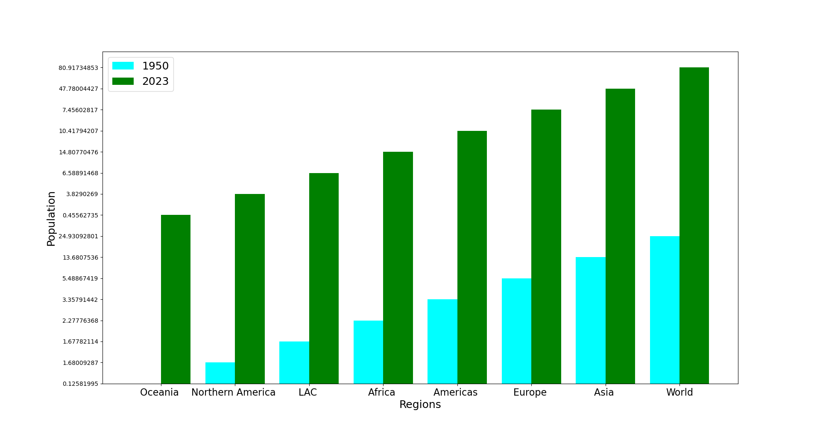
1950 vs 2023
Fig 6. Comparison 1950 v 2023

Slide 10
Resources
Data Collection : https://ourworldindata.org/population-growth
Table 1. Population in major land masses : https://ourworldindata.org/population-growth
Fig 3. Word cloud depicting negative effect of population increase : https://chatgpt.com/
Fig 4 Global surface temperature : https://www.climate.gov/news-features/understanding-climate/climate-change-global-temperature
Fig 5. World map for annual deforestation rate : https://ourworldindata.org/deforestation
https://github.com/53-97/Tools_-_Methods_Data_Analysis.git

Slide 11
Thank you
You can check out our python codes in the below mentioned repository
https://github.com/53-97/Tools_-_Methods_Data_Analysis.git
PRESENTED BY: Abhishek Negi & Aakash
Msc. Computer science(cohort 2025)
Subject : Tools & Methods of data analysis
Contact info: abhishek.negi53@gmail.com

